Slide 1
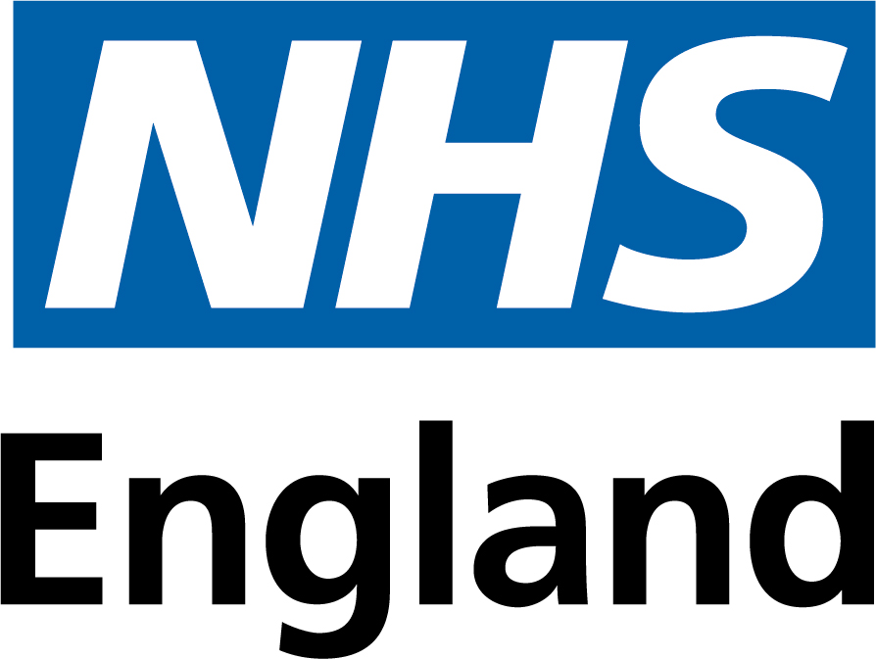
DTX OPERATING MODEL · SALES PACK
PATIENT GROUP
Care that meets you where you are.
One operating model. Three workstreams. Built around real people. A story for patients and the groups who represent them.
Digital Therapeutics · HomeTest · HealthStore · HealthSync

Slide 2
THE REALITY
Three services. One health journey. None of them talking to each other.
For most patients, what is meant to be one health journey arrives as three separate experiences.A blood test from one route. An app from another. A wearable from a third. Different logins, different consent forms, different conversations with different care teams.The operating model is the answer to that fragmentation. The same patient, the same record, the same NHS App as the front door, across all three.
DTx Operating Model · Sales pack · Patient group
2 of 11

Slide 3
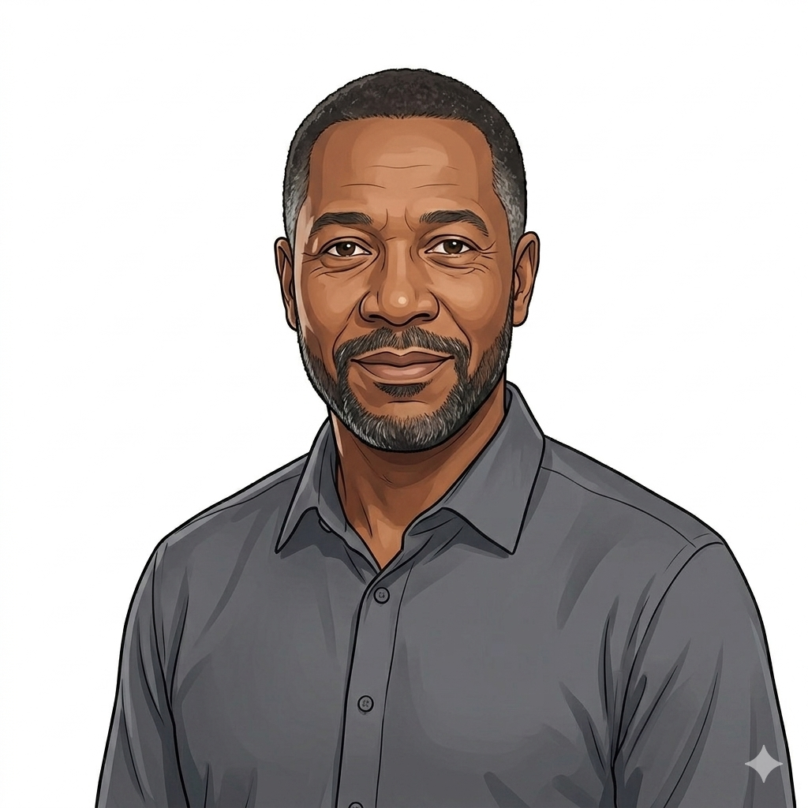
MEET ERROL
Hypertension. Fifty-six. Two grown daughters. No symptoms that morning.
“I felt fine. I had the cuff at home for the BP, I had the watch on my wrist, I had the app on my phone. None of those felt like much on their own. Then the GP called before I knew anything was wrong. That call was every one of them working at the same time.”
ERROL · THE PATIENT WHO DID NOT HAVE TO EXPERIENCE THE OPERATING MODEL
DTx Operating Model · Sales pack · Patient group
3 of 11

Slide 4
THE MORNING
Three workstreams working at once, in a way Errol never had to think about.
HEALTHSYNC · THE WATCH
HOMETEST · THE KIT
HEALTHSTORE · THE SUPPORT
The wearable caught the signal
Bloods at home, fast turnaround
A digital therapeutic alongside the medication
A subtle pattern shift in Errol’s resting heart rate and the way it lined up with his BP readings was the early flag. The watch did the watching. The GP got the alert.
A test kit on the doorstep two days later. Kidney function, lipids, HbA1c. Result in the record. No surgery visit needed to confirm what the data already suggested.
Reminders, breathing exercises, the supported behaviour change that makes the medication land. Prescribed normally, accessed through the NHS App he was already using.
DTx Operating Model · Sales pack · Patient group
4 of 11

Slide 5
WHAT CHANGED FOR ERROL
One onboarding. One consent. One record. Three workstreams.
Errol onboarded once, to the NHS App. NHS Login carries his identity into every part of the model. He never created three accounts.He gave consent once, for the use of his data across the integrated record. He never re-consented to three suppliers.His record is one record. His care team sees one person, not three views of him.The patient experiences one service. The architecture underneath does the joining-up work he was never asked to do.
DTx Operating Model · Sales pack · Patient group
5 of 11

Slide 6
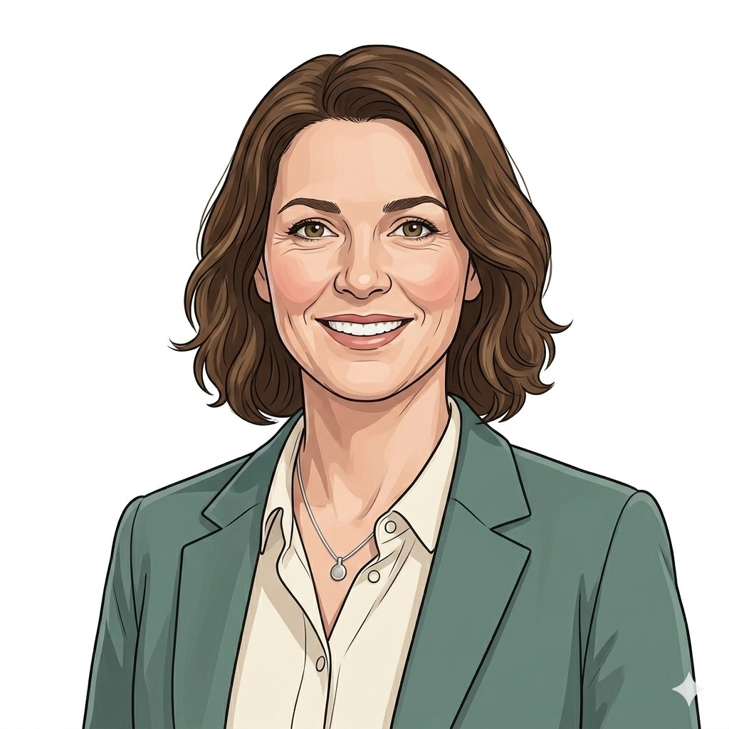
WHY THIS TOOK SOMEONE TO FIGHT FOR IT
A commissioner like Sarah ran one procurement instead of three, so the patients in her population got this within the year.
“The old way would have been three procurements, three IG assessments, three integration projects, three sets of MI. Eighteen months minimum. The framework let me sign once and call off three workstreams together. The year I got back is the year my patients got this in.”
SARAH · ICB COMMISSIONER
DTx Operating Model · Sales pack · Patient group
6 of 11

Slide 7
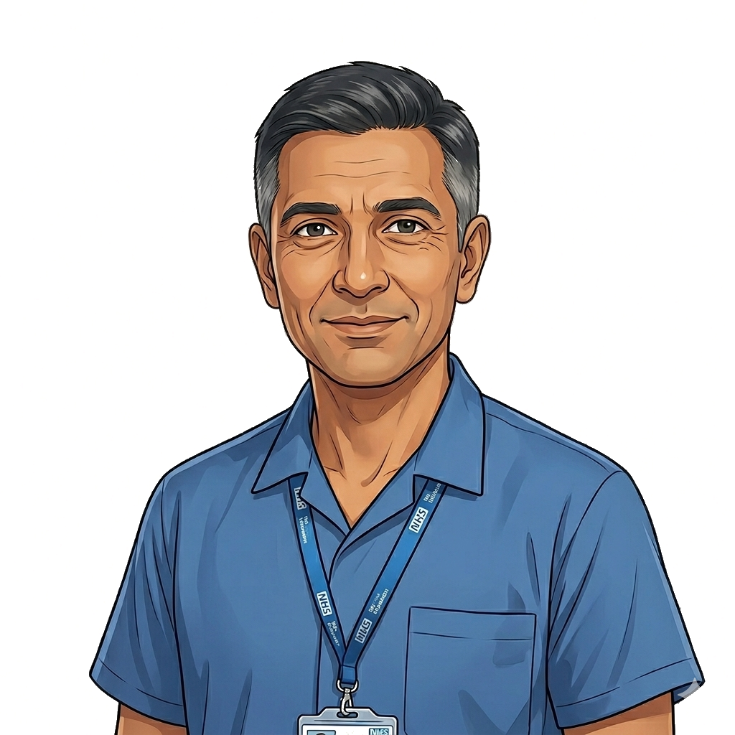
WHY THIS TOOK SOMEONE TO BE WILLING
A clinician like Ravi has to be able to defend the digital therapeutic in front of a medical team, the way he would any other clinical decision.
“The assurance work that lets me prescribe a digital therapeutic was done once at the centre. NICE EVA conditional admission, the clinical-safety case, the named accountability if something goes wrong. That cover is what stopped me being a sceptic.”
RAVI · CONSULTANT RESPIRATORY PHYSICIAN
DTx Operating Model · Sales pack · Patient group
7 of 11

Slide 8
THE MODEL IN ONE SLIDE
What patients should never have to see, and what should always feel like one NHS.
Foundation
WHAT THIS MEANS FOR YOU
One framework, one assurance bar, one contract architecture, one MI feed
You onboard to one NHS App. NHS Login carries your identity across everything.
You give consent once for the integrated record. You never re-consent for each supplier.
Your care team sees one person, not three views of you.
The clinical assurance, the contracting, and the data integration are done once at the centre. None of it lands on your kitchen table.
When something goes wrong, the named accountability is clear. There is one named clinical-safety contact, not three.
Overlay
Per-product configuration: HomeTest, HealthStore, HealthSync
Pattern
Deployment shapes admitted under the framework
Configuration
The product-specific operating shape for each pathway
DTx Operating Model · Sales pack · Patient group
8 of 11

Slide 9
THE ASK
Tell us where the model still does not fit the lives of the people you represent.
1
2
3
Name what is still missing
Sit on the clinical reference group
Help us test the next wave
Patient groups know the edges of the service better than any commissioner. Tell us where Errol’s story still does not hold for your members.
A patient or lay representative sits on the regional clinical reference group that decides which configurations are admitted next. We want that voice to be yours.
The model extends to new conditions and pathways over time. Patient groups help us decide which to admit first, on what terms, and for whom.
DTx Operating Model · Sales pack · Patient group
9 of 11

Slide 10
CLOSING
Errol’s mornings are everyone’s mornings.
The operating model exists so that the joining-up work, the procurement work, the assurance work, the integration work, the clinical-safety work, the contracting work, is done once at the centre. The patient experiences one service. That is the whole point.

Slide 11
Thank you
Questions, challenges and corrections welcome.
11 of 11

